Slide 1
The Covid Pandemic, a period of significant financial stress?
Aleksa Mihajlovic – Market Risk Analyst – Deutsche Bank AG Berlin – June 2022

Slide 2
The Covid Pandemic, a period of significant financial stress?
What is Financial Stress?
Financial Stress is a disruption in the functioning of financial markets characterized by:
Increased uncertainty about the fundamental value of assets
Increased asymmetry of information
Unwillingness to hold risky or illiquid assets 1*
Financial Crisis is a period of extreme stress in global financial markets and banking systems 2*
1* The OFR Financial Stress Index – US Deparmtent of Treasury – https://www.financialresearch.gov/financial-stress-index/
2* Reserve Bank of Australia - https://www.rba.gov.au/education/resources/explainers/the-global-financial-crisis.html

Slide 3
The Covid Pandemic, a period of significant financial stress?
Financial Stress Index (FSI)
FSIs can be used to quantify and mutually compare financial stresses / financial crises
Many FSIs have been designed since the Financial Crisis of 2008
FSIs are comprised of selected indicators (time series of market data) which best represent the financial markets.
FSIs differ based on the methodology used to combine the indicators (averages, PCAs, Dynamic Factor Models, Portfolio Theory)
1* The OFR Financial Stress Index – US Deparmtent of Treasury – https://www.financialresearch.gov/financial-stress-index/

Slide 4
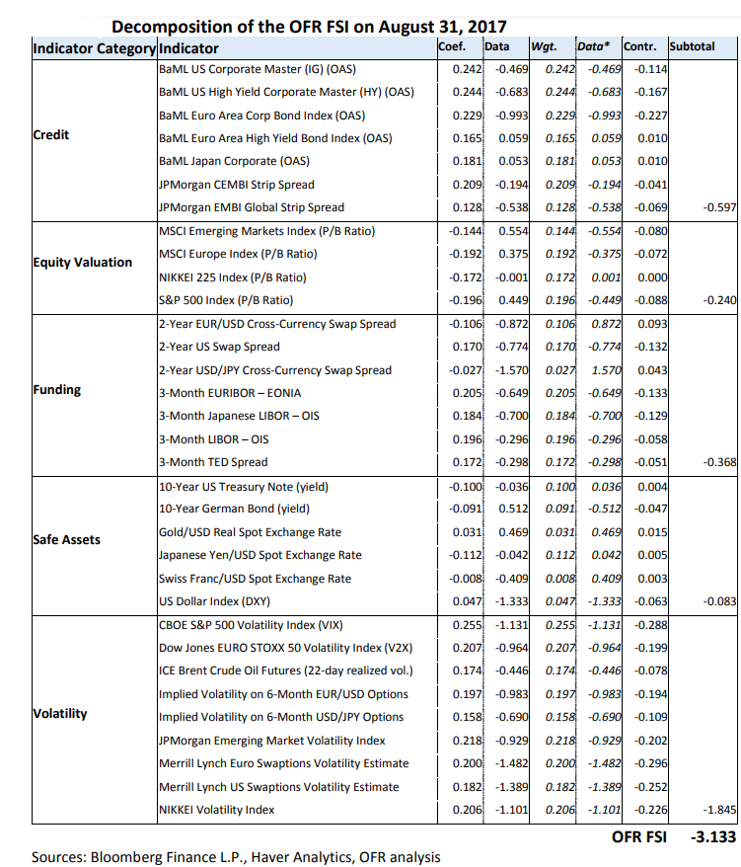
The Covid Pandemic, a period of significant financial stress?
OFR – FSI
Office for Financial Research (US Treasury)
Comprises 33 indicators in 5 categories
Credit – credit spreads
Equity – stock indices
Funding – overnight rates, IR spreads
Safe Assets – treasury note yields, exchange rates
Volatility – VIX, implied volatilities

Slide 5
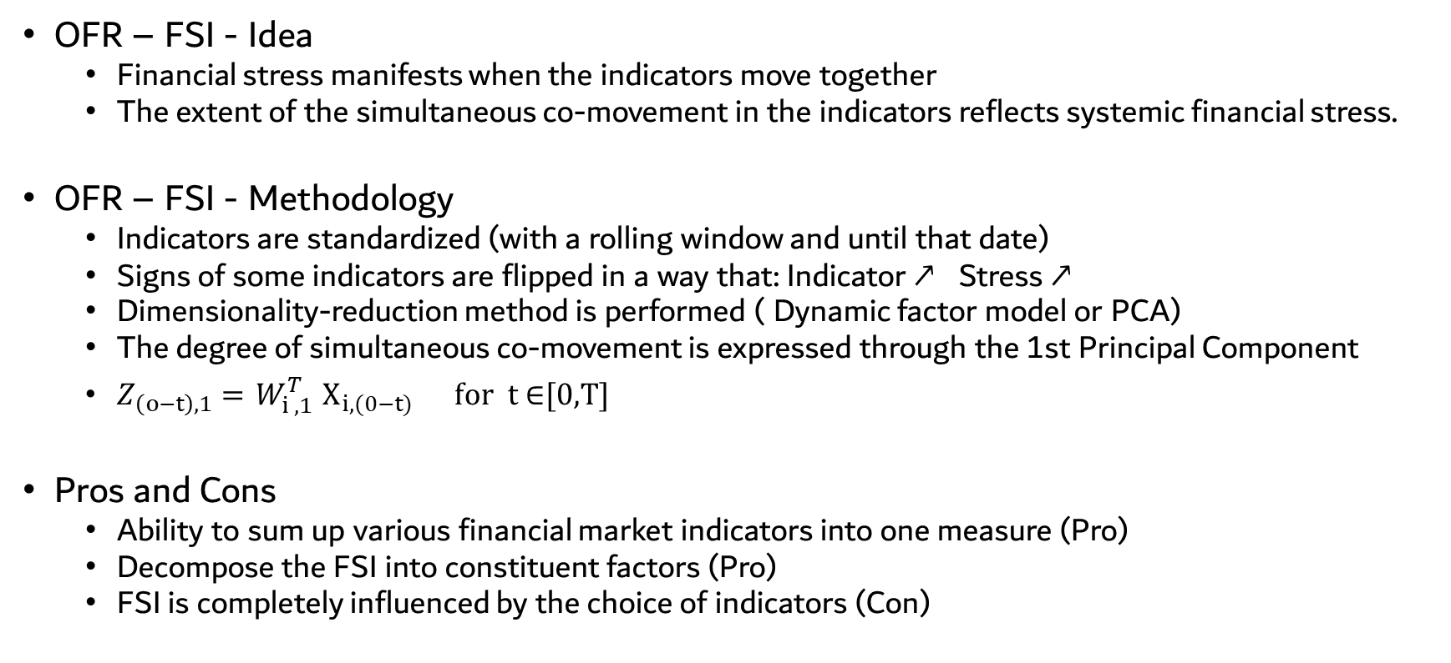
The Covid Pandemic, a period of significant financial stress?
OFR – FSI - Idea
Financial stress manifests when the indicators move together
The extent of the simultaneous co-movement in the indicators reflects systemic financial stress.
OFR – FSI - Methodology
Indicators are standardized (with a rolling window and until that date)
Signs of some indicators are flipped in a way that: Indicator ↗ Stress ↗
Dimensionality-reduction method is performed ( Dynamic factor model or PCA)
The degree of simultaneous co-movement is expressed through the 1st Principal Component
$Z_{\left(o−t\right),1}={ W}_{i ,1 }^{T}X_{i,(0−t)} \text{for} \text{t} \text{∈}\text{[}\text{0,}\text{T}\text{]}$
Pros and Cons
Ability to sum up various financial market indicators into one measure (Pro)
Decompose the FSI into constituent factors (Pro)
FSI is completely influenced by the choice of indicators (Con)

Slide 6
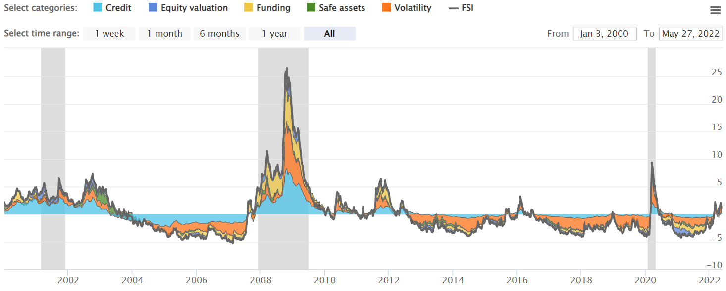
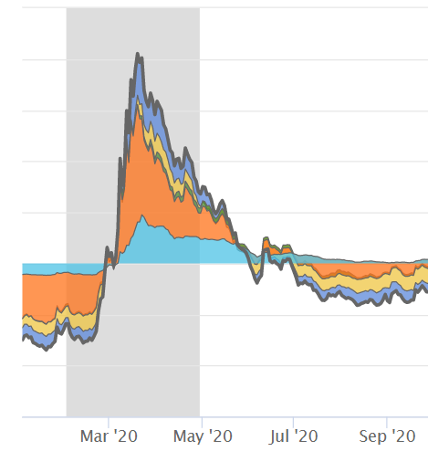
The Covid Pandemic, a period of significant financial stress?
OFR – FSI
Source: https://www.financialresearch.gov/financial-stress-index/

Slide 7
The Covid Pandemic, a period of significant financial stress?
Custom made FSI
Focus on the US Financial Market
10 Indicators in 4+ Asset Classes (Credit, Equity, Rates, FX, Commodities)
BaML US Corporate Master (IG) OAS
BaML US Corporate Master (HY) OAS
S&P 500 Growth Index (SPDR – SPYG - ETF )
S&P 500 Value Index (SPDR – SPYV - ETF )
US Treasury Note Yield 10 years
US Treasury Note Yield 30 Years
USD-EUR Spot
USD-JPY Spot
WTI-USD
XAU- USD
Code available at: https://github.com/maleckicoa/FSI_Covid
Data sources: FRED St Louis FED ; Investing.com ; Yahoo Finance

Slide 8
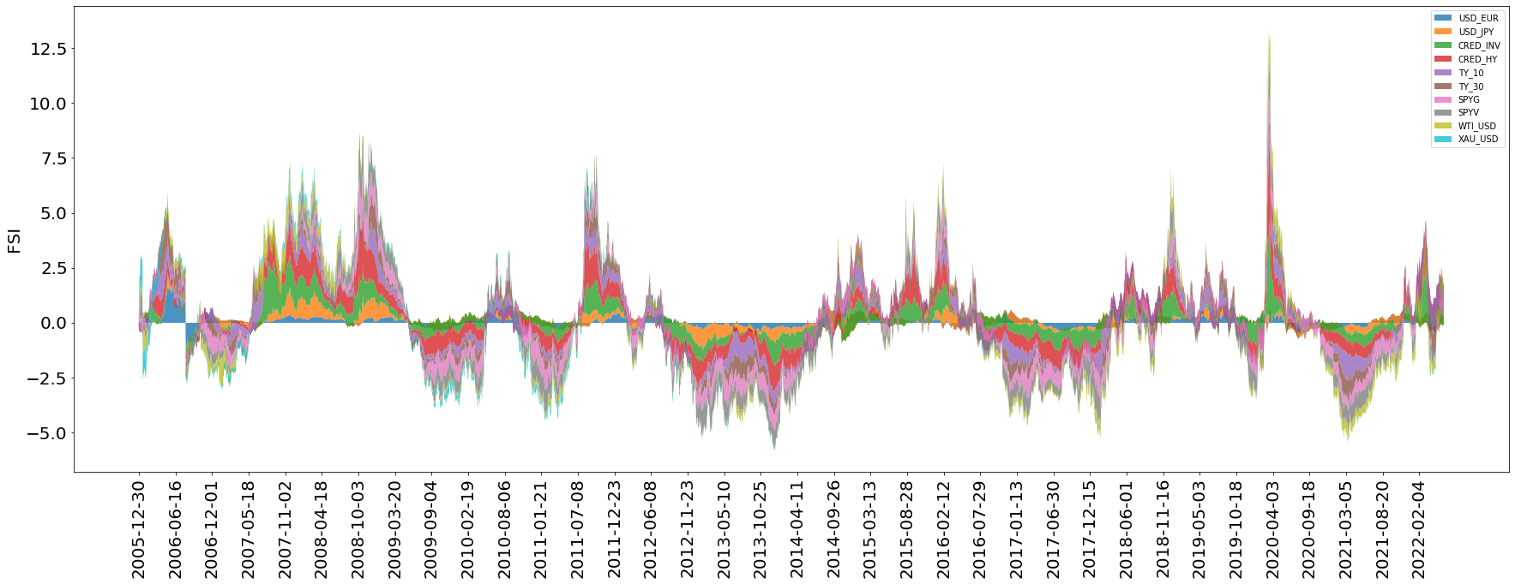
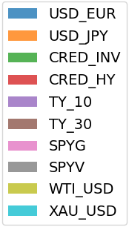
The Covid Pandemic, a period of significant financial stress?
Custom made FSI

Slide 9
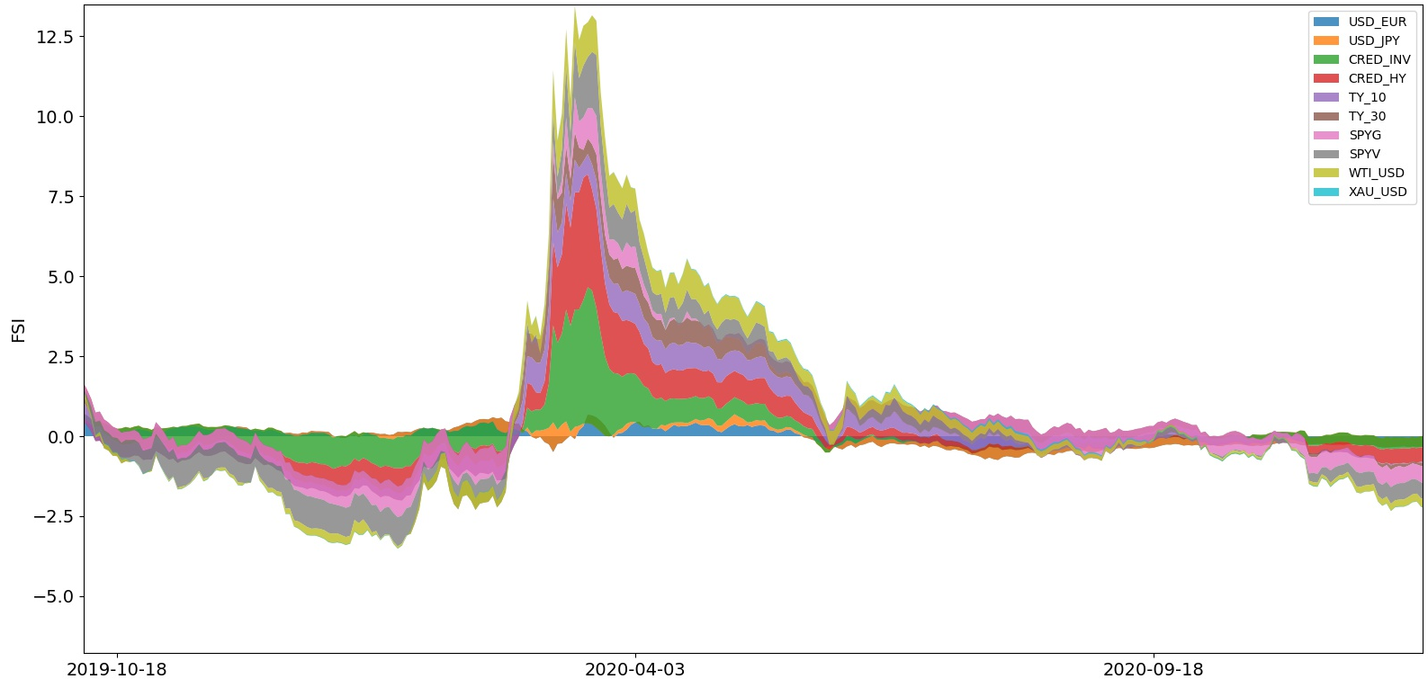
The Covid Pandemic, a period of significant financial stress?
FSI – Covid 19 Pandemic

Slide 10
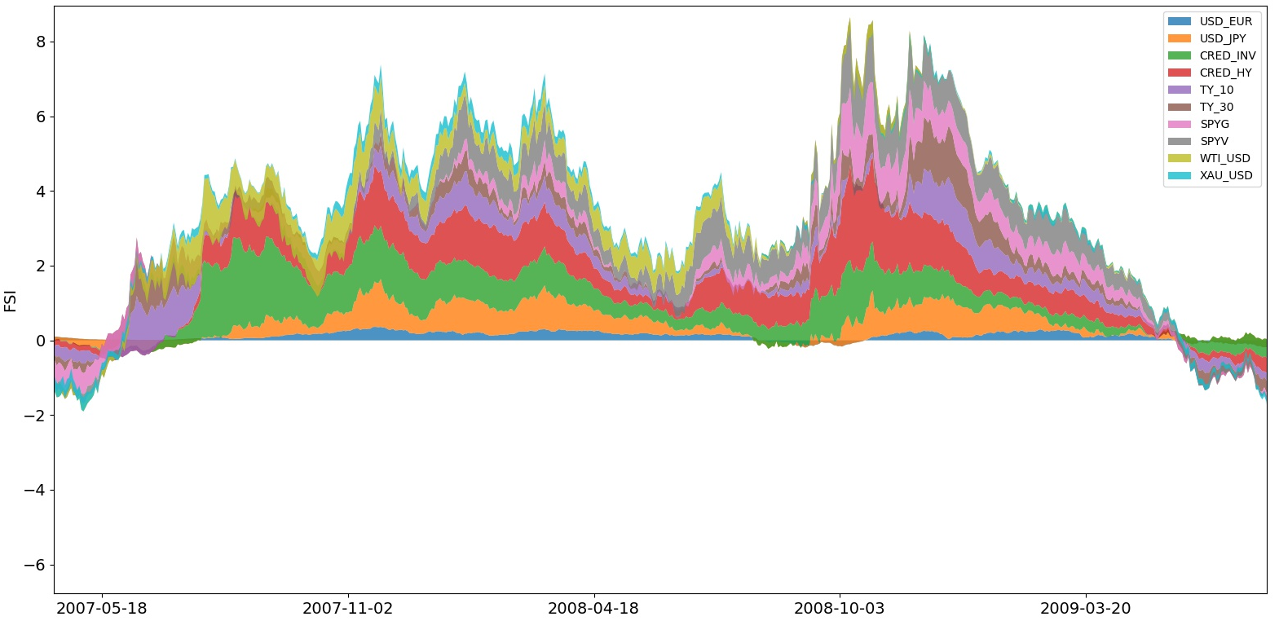
The Covid Pandemic, a period of significant financial stress?
FSI – Financial Crisis of 2008/2009

Slide 11
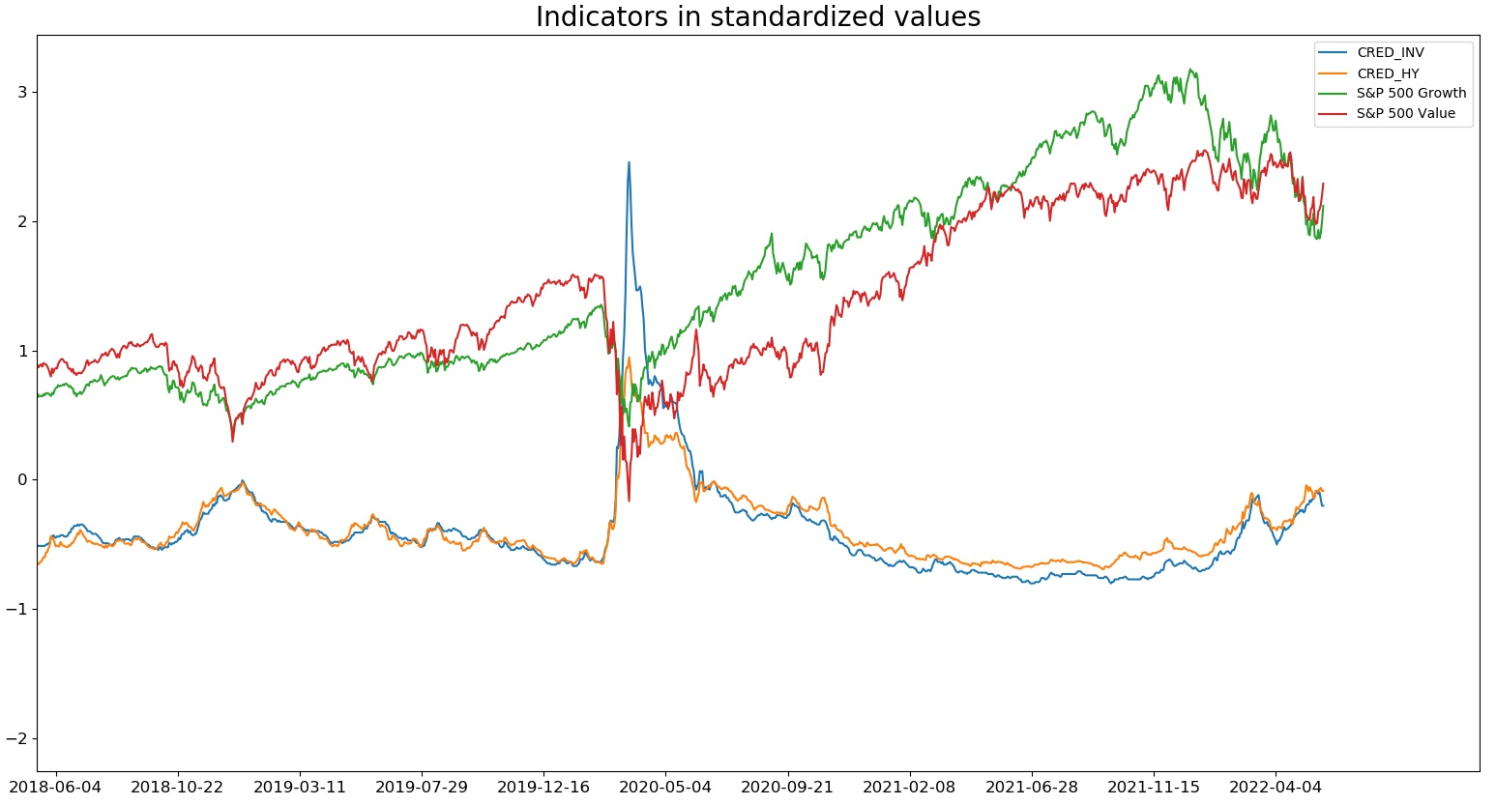
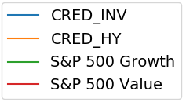
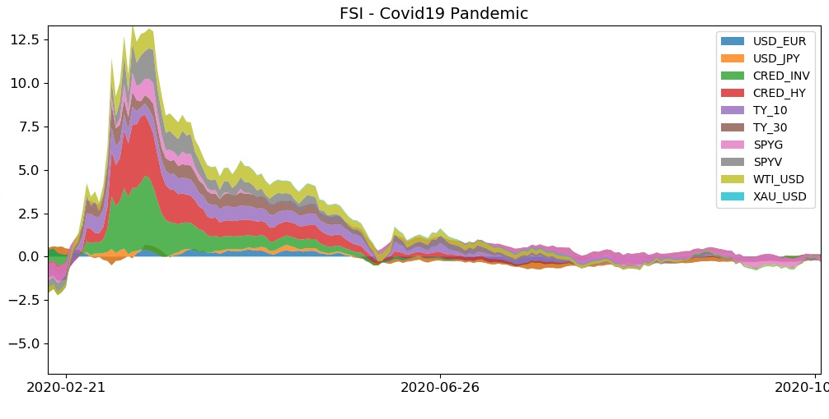
The Covid Pandemic, a period of significant financial stress?
Covid Crisis impact on Financial Markets
Credit spreads (standardized) experienced more stress than Equity prices

Slide 12
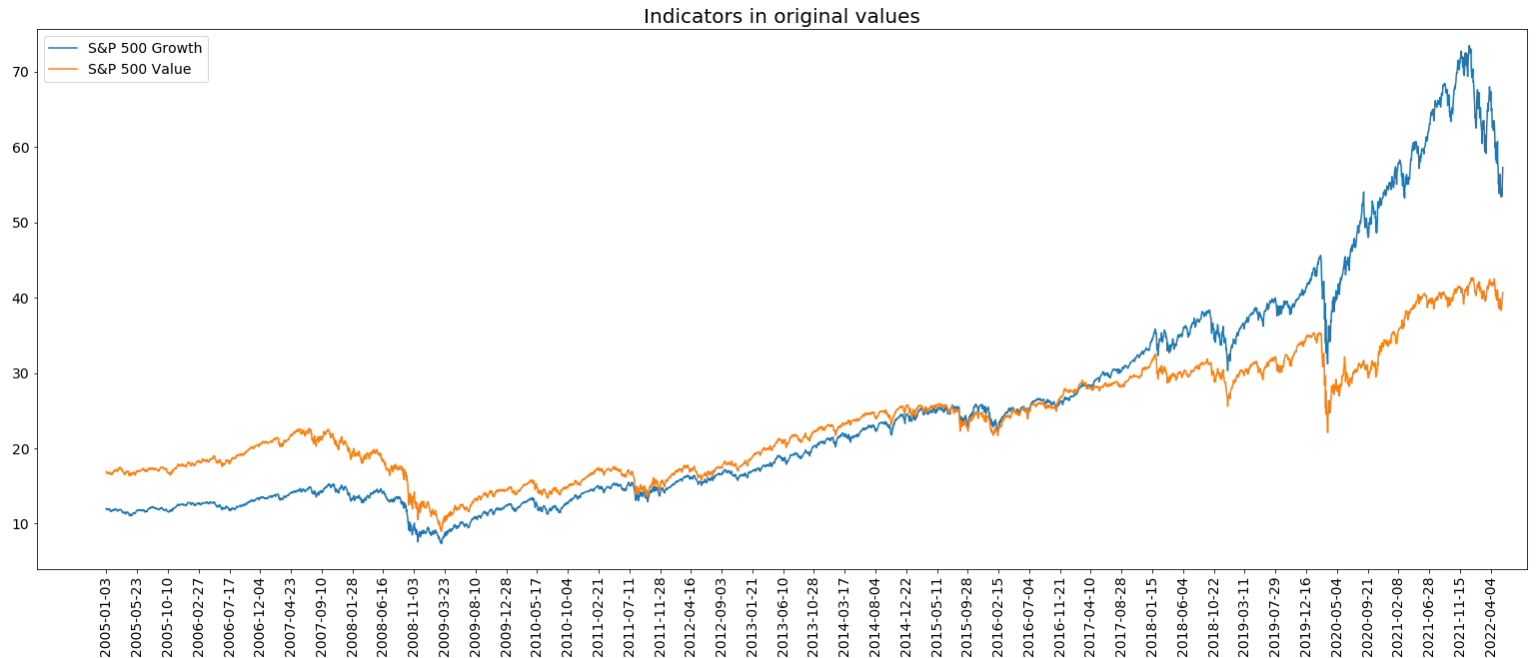
The Covid Pandemic, a period of significant financial stress?
Covid Crisis impact on Financial Markets
Growth Stocks performed better than Value Stocks

Slide 13
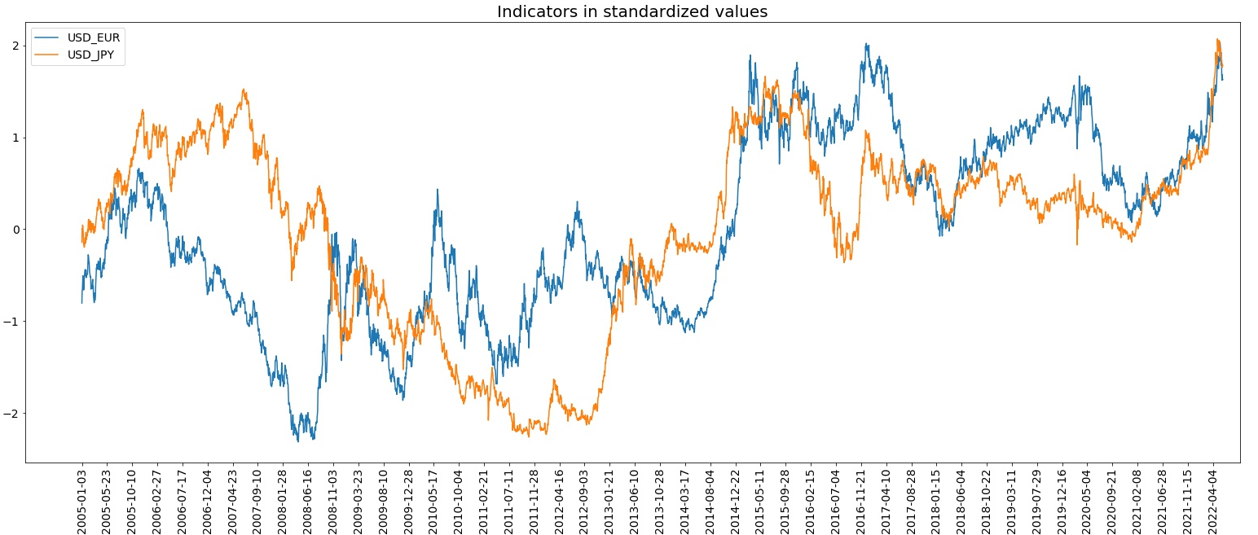

The Covid Pandemic, a period of significant financial stress?
Covid Crisis impact on Financial Markets
USD was mostly stable

Slide 14
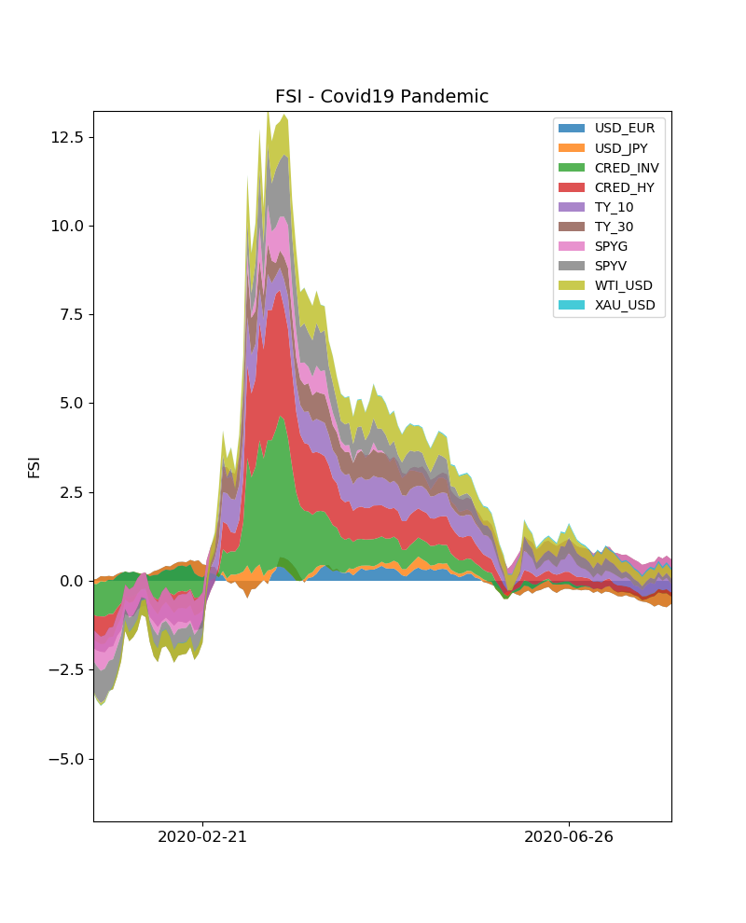
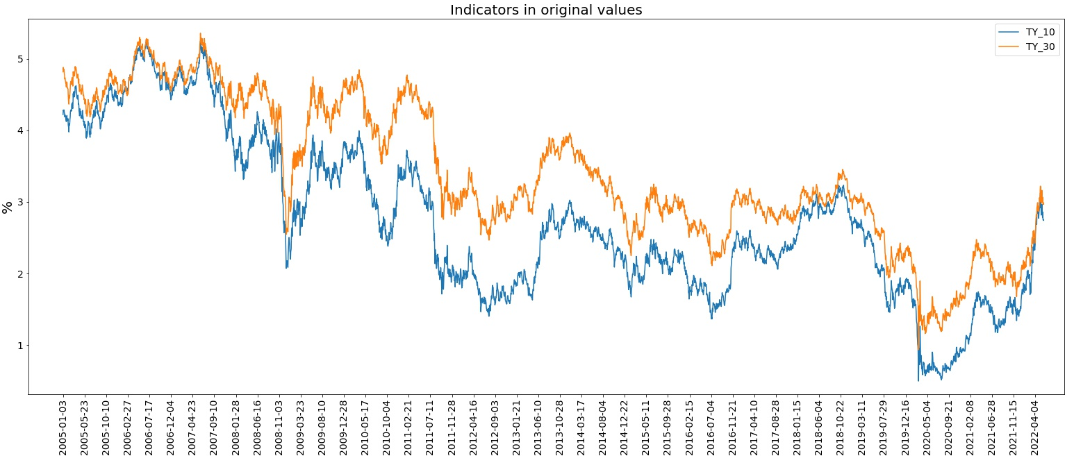

The Covid Pandemic, a period of significant financial stress?
Covid Crisis impact on Financial Markets
Treasury Yields fell as investors run for safety

Slide 15
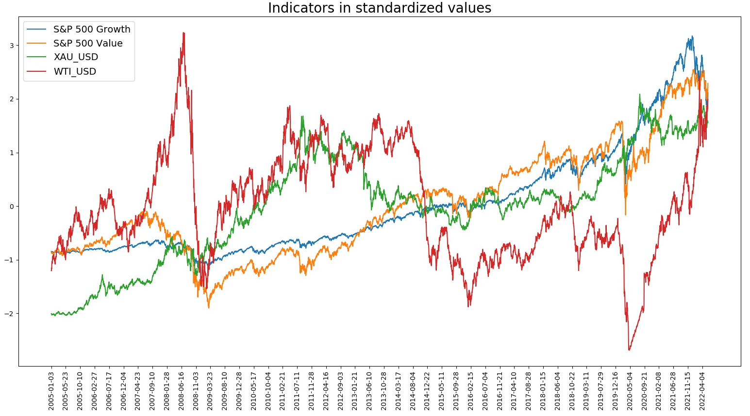
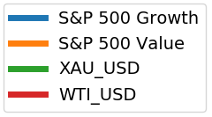
The Covid Pandemic, a period of significant financial stress?
Covid Crisis impact on Financial Markets
Gold – price quite uncorrelated with other assets
Oil – high price volatility

Slide 16
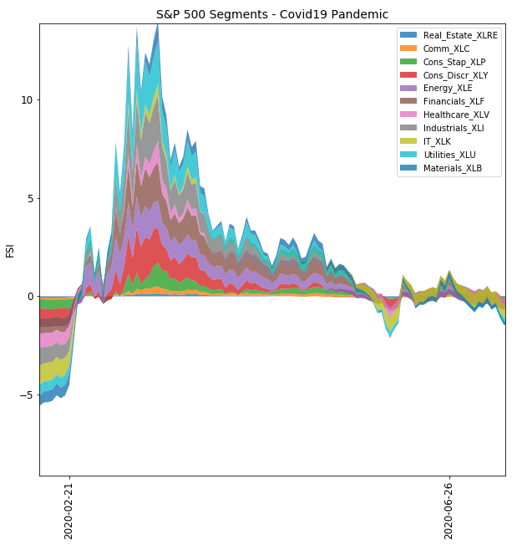
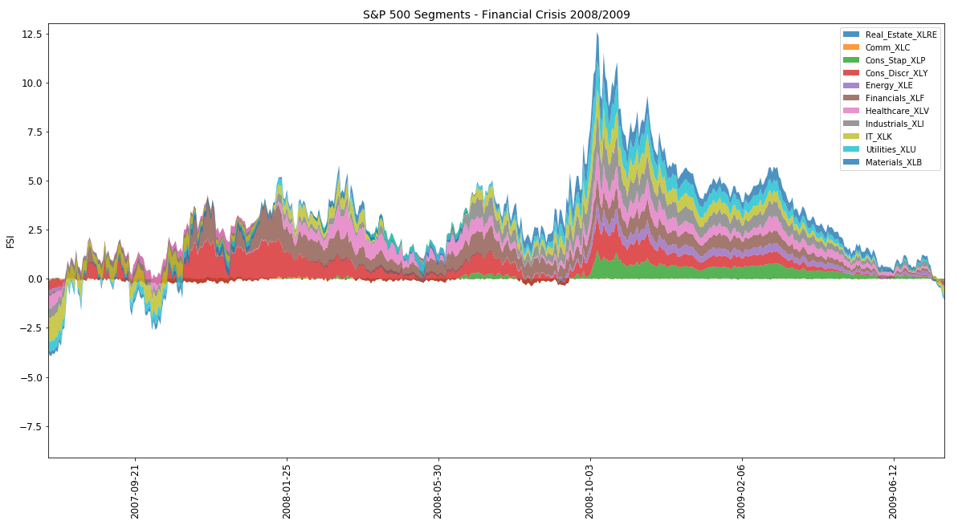
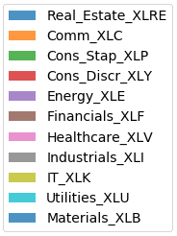
The Covid Pandemic, a period of significant financial stress?
Covid Crisis impact on S&P 500 Market Segments

Slide 17
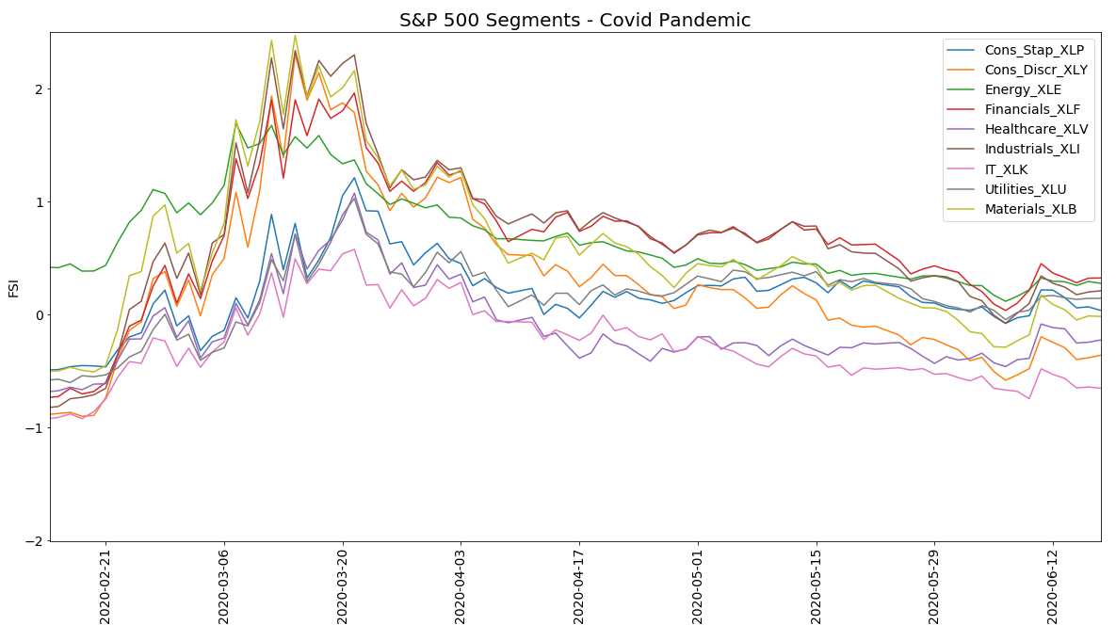
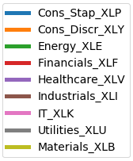
The Covid Pandemic, a period of significant financial stress?
Covid Crisis impact on S&P 500 Market Segments
High Stress sectors
Materials
Consumer Discretionary
Energy
Financials
Industrials
Low Stress sectors
Technology
Consumer Staples
Utilities
Healthcare
Incomplete Data
Real Estate
Communications

Slide 18
The Covid Pandemic, a period of significant financial stress?
Managing the Risk
Approaches would differ depending on the nature of the financial instituion
In Investment Banking (Market Making)
Shift towards more liquid assets
Update the Credit Ratings
Adapt the Stress Tests (adopt new scenarios)
Widen the bid-ask spread

Slide 19
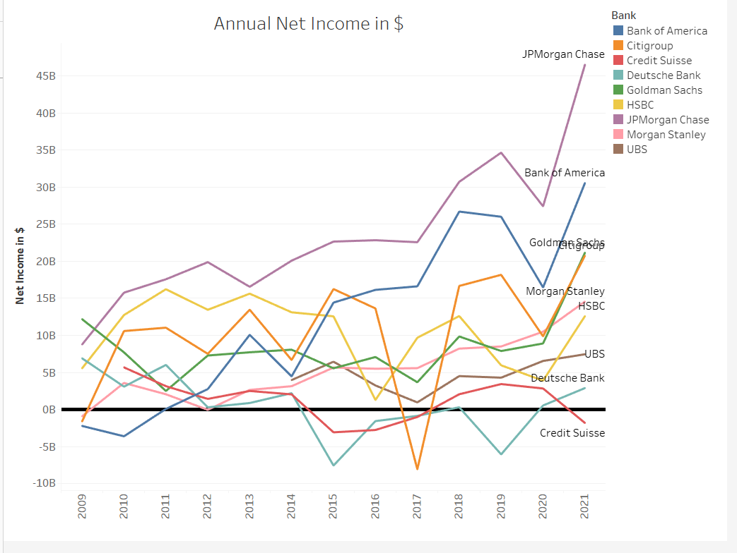
The Covid Pandemic, a period of significant financial stress?
Effect on Investment Banks

Slide 20
The Covid Pandemic, a period of significant financial stress?
Thank you for your attention
Aleksa Mihajlovic – Market Risk Analyst – Deutsche Bank AG Berlin – June 2022

